Slide 1

Final Project Presentation INST 377
Weather App
Sang Hwa Lee

Slide 2
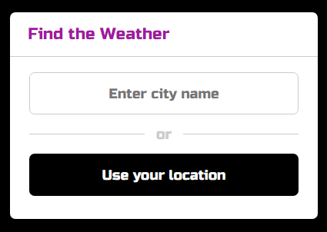
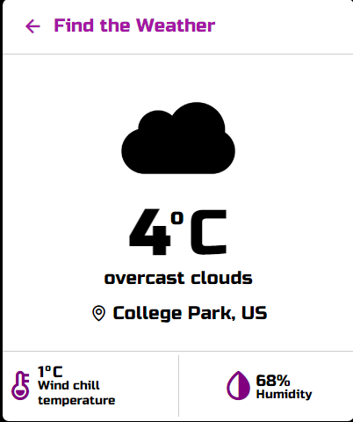
Weather App

Slide 3
Initial Problem
Database:
The database I chose contains data that provides the weather condition.
Information Problem
It is difficult for users to know the weather because weather websites provide too much information.
Most weather websites offer only local weather in the United States.
Solution:
Create weather apps so that users can get weather information easily and quickly.

Slide 4
Stakeholders
Travelers
Residents
Students who interested in meteorology or related information
Researchers

Slide 5
Successes
Good Design _ Simple
Used Geolocation
Humidity and Wind chill temperature

Slide 6
Challenges
How to use API key
Make the geolocation
Weather icon setting

Slide 7
Overcome
Discord
Useful Website

Slide 8
Demonstration
Weather app Link
https://slee0819.github.io/Final_Project_INST-377_Weather_App/

Slide 9
Next Steps
Expand towards the national weather service
More functionality ( Map, Forecast screen)
Adding better visualization for weather data

Slide 10
Thank you.

